Slide 1
An Exploration of the Activities and Concerns of Higher-burden Family Caregivers as represented by NFCA Members Presentation to the National Respite Conference November 3, 2011
NFCA/Allsup Family Caregiver Survey
Notes:
High Burden Self-Identified Family Caregivers Across the Lifespan: A Niche Population Both Feisty and in Need

Slide 2
About NFCA
NFCA is the nation’s family caregiver organization helping family caregivers build their confidence and capabilities through education, community, and advocacy, and striving to remove the barriers that make caregivers’ lives so much harder than they need to be.
NFCA addresses the needs and concerns of all family caregivers regardless of their loved one’s age or diagnosis. Visit us at:
www.thefamilycaregiver.org

Slide 3
Methods
NFCA and Allsup worked with independent research consultant Karen Gershowitz of Strategic Action, Inc. to develop the survey.
1,579 Family Caregiver members of NFCA who subscribe to the organization’s E-letter responded to email solicitation to complete an online survey.
Surveys were completed in March and April of 2011.
Richard Day Research was responsible for data management, analysis and reporting.
Caveat: This is not a random sample of all caregivers. However, the findings provide important insights to the challenges and issues facing this group of higher-burden family caregivers.

Slide 4
Selected Objectives
Identify differences in
Family Caregivers’:
Activities
Needs
Concerns
Interests
According to variations in:
• Caregiver/care recipient relationship
• Care recipient diagnosis
• Extent of caregiving responsibility/availability of help
• How caregiver role developed (suddenly or over time)
Notes:
We wanted to explore the correlations between various aspects of caregivers’ experiences so we could get a deeper
understanding of their similarities and differences

Slide 5
NFCA Family Caregivers
Care for loved ones across the lifespan
42% care for a parent
36% care for a spouse
14% for a child
69% are in their middle years – age 45 – 64
48% are employed full or part-time
65% have household incomes under $60,000
85% Caucasian
33% care for a loved one whose condition severely limits their ability to care for themselves, such as Alzheimer’s or Parkinson’s disease, muscular dystrophy, spinal cord or brain injury, etc.
Only 2% volunteered that the primary reason for providing care is aging
Notes:
This is the basic profile of the family caregivers we communicate with all the times
40% incomes under $39,000 (175% over the federal poverty level for a family of four)
$60,000 - 300% over federal poverty level

Slide 6
Hallmarks of a Higher Burden
• 32 % provide care for more than one person
57% have been providing care for more than five years
• 52% are the sole or primary caregiver
Nearly two-thirds of spouses (65%) say they are the sole caregiver and report the lowest levels of help
On average, helped with 2.6 ADLs and 4.9 IADLs
67% of family caregivers live with their care recipient
Notes:
You can easily see why we refer to NFCA’s members as higher burden caregivers
I was really surprised by the average number of IADLs and ADLs – because I deal with all of them and so I am wondering where
the other folks like me are

Slide 7
Caregiving Role One third of parents caring for a child say they are the sole caregiver and report the highest levels of help.
Almost half of caregivers report they are the sole caregiver.
Spouses are most likely to be sole caregivers.
 | Who providing care for?
Gap | Spouse | Child | Parent | Other
Sole | 65% | 33% | 41% | 30%
Primary with help | 32% | 51% | 42% | 32%
One of several | 1% | 10% | 10% | 19%
Help others | 2% | 5% | 7% | 13%
Paid | 0 | 1% | 0 | 7%
13. Which of the following statements best describes your caregiving role?
Notes:
7
7
More evidence of their higher burden
Note - One of several – should be interpreted as a team while
help others - are people who assist informally

Slide 8
Which Came First? Diagnosis or Caregiving?
For a majority of caregivers,
caregiving began right away (39%) or even before a diagnosis (14%).
This is especially true of those caring for a child.
 | Who providing care for?
When Care Began | Spouse | Child | Parent | Other
Before diag. | 10% | 23% | 16% | 14%
At diag. | 35% | 54% | 39% | 24%
Within year | 23% | 15% | 20% | 18%
1 to 5 years | 13% | 4% | 15% | 11%
>5 yrs. | 19% | 4% | 10% | 33%
Notes:
8
8
I found this data really disturbing –Across all of these relationships only parents of kids with special needs got a diagnosis right away at least 50% of the time. No one else came close.
Some people started caregiving before a diagnosis – and some more than 5 years later. Can you imagine the stress that comes
with not knowing what is involved and the stress that comes from waiting for a shoe to drop because a diagnosis exists. I can
relate to that – it plays havoc with your emotions and your relationship, knowing bad things are coming, but you can’t really do
anything about it. Today there are drugs for MS, which is what Steven (my husband) has and for Alzheimer’s – they don’t cure
but they slow progress, buy you time, that’s why getting early diagnoses early is important.

Slide 9
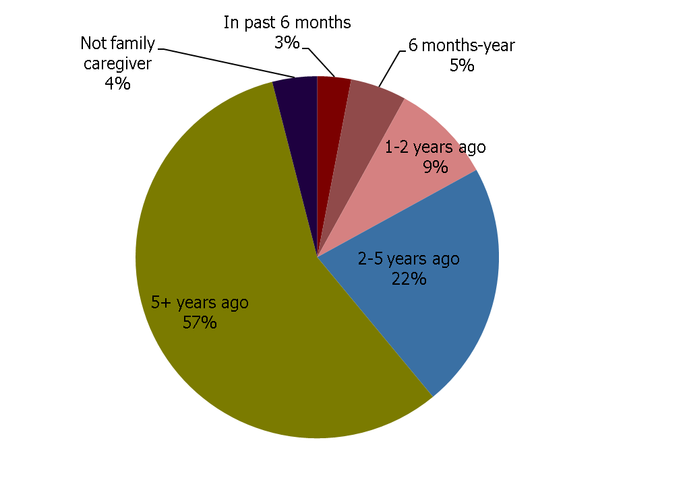
When Did You Think of Yourself as Family Caregiver?
A majority of respondents have thought of themselves as a family caregiver for more than 5 years.
Q11. When did you think of yourself as a family caregiver?
Notes:
9
9
Caregivers associated with NFCA self identify
We don’t know if their association with us caused them to self-identify or they self-identified previously and that’s why they
came to us. Something for us to look into. The answer will be very telling
Regardless - we now can identify a population of self-identified family caregivers and further research can shed light on how
they are similar or different from those that don’t self identify

Slide 10
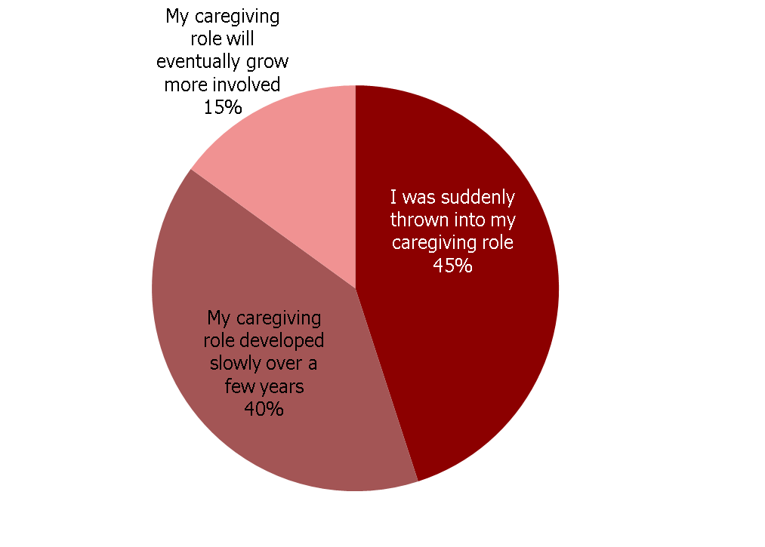
How Caregiver Role Evolved
Almost half of caregivers felt like they were suddenly thrown into the caregiving role.
Q12. Which statement best describes your situation?
Notes:
10
10
Some people become family caregivers suddenly – someone has a stroke, is in a car accident. Other times as we’ve already noted
it happens gradually. What you’ll see on other slides is that this perception has an impact on a number of other aspects of their
caregiving experience.

Slide 11
Primary Diagnosis of Care Recipient
(n=1,496) | %
Alzheimer’s Disease (confusion, dementia) | 21%
Stroke and related disorders | 12%
Multiple Sclerosis | 8%
Brain damage or traumatic brain disease | 6%
Parkinson’s Disease | 5%
Spinal disease or disorder / spinal cord injury | 5%
Cancer | 4%
Heart disease | 4%
Aging (volunteered) | 2%
Many others <3%
Caregivers are faced with a wide array of conditions, but the top nine account for 2/3 of all diagnoses.
Alzheimer’s Disease was mentioned most often, with 1 in 5 reporting this was the care recipient’s primary diagnosis.
Note: Survey asked only for primary diagnosis and did not capture information on co-morbid conditions.
Notes:
11
11
This is FYI info - Not being a representative sample of family caregivers we can only look at the relationship of diagnosis to other
factors based on the diagnoses of our constituents, and only Alzheimer’s would seem to have statistical relevance. Regardless it
is interesting to note that almost a quarter (24%) fit into the category of neuro-degenerative diseases.

Slide 12
Primary Diagnosis & How Caregiver Role Evolved
The evolution of the caregiver role is most related to the primary diagnosis.
Those with recipients suffering an acute event, or a birth-related condition are more likely to feel thrown into the role.
Those with recipients suffering from a degenerative condition are more likely to say their role developed slowly over a few years.
Primary Diagnosis (n= 1,476) | % caregivers saying thrown into role
Brain damage (n= 95) | 75%
Stroke related (n= 181) | 70%
Spinal damage (n= 71) | 69%
Cerebral palsy (n= 43) | 61%
Developmental disorder (n= 33) | 61%
Primary Diagnosis (n= 1,476) | % caregivers saying role developed slowly
Multiple Sclerosis (n= 116) | 53%
Parkinson’s disease (n= 70) | 50%
Alzheimer’s (n= 306) | 49%
Heart disease (n= 59) | 49%
Notes:
12
12
When you see the correlations this slide will have relevance – gradual or sudden onset seems to be a factor in other aspects of
caregiving

Slide 13
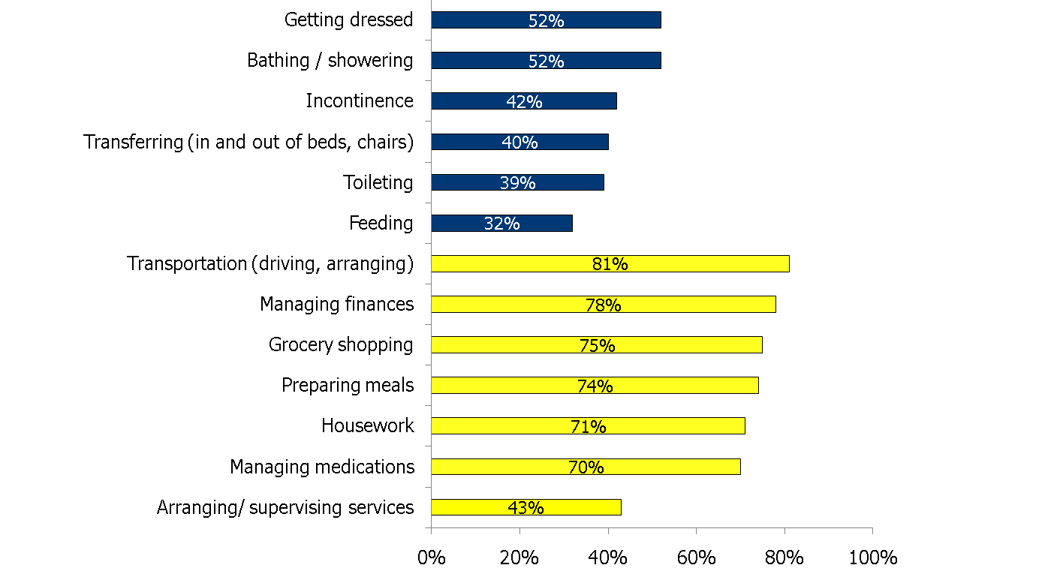
ADLs & IADLs
On average, caregivers helped with 2.6 of 6 Activities of Daily Living
(ADLs), and 4.9 of 7 Instrumental ADLs (IADLs).
ADLs
IADLs
Q16. With which of the following do you assist your care recipient? (Select as many as apply)
Notes:
13
13
Again FYI _ These are the activities that the survey respondents deal with – given the percentages you can see these caregivers
Are higher burden

Slide 14
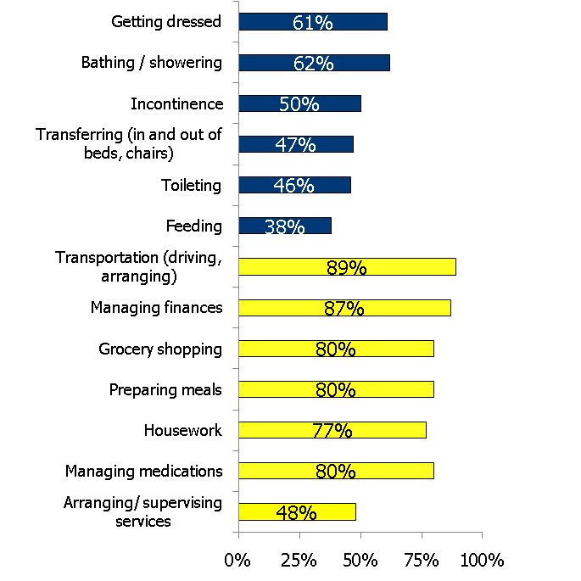
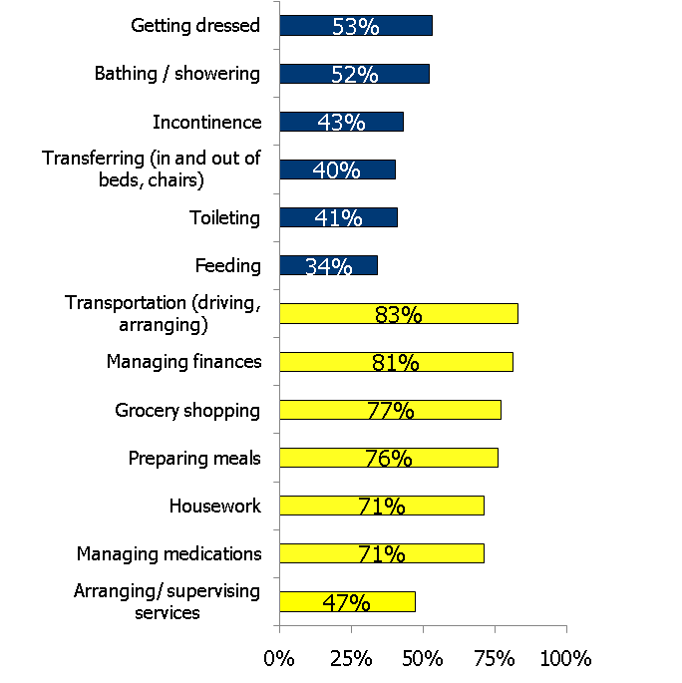
ADLs and IADLs by Evolution of Caregiving Role
Thrown Suddenly Into Role
Role Developed Slowly
ADLs
Avg 3.0
ADLs
Avg 2.0
IADLs
Avg 5.4
IADLs
Avg 5.0
Q16. With which of the following do you assist your care recipient? (Select as many as apply)
Notes:
14
14
You can see here how the activities break down by how caregiving developed. Those who were thrown into caregiving are
showing a higher burden than those whose caregiving grows gradually

Slide 15
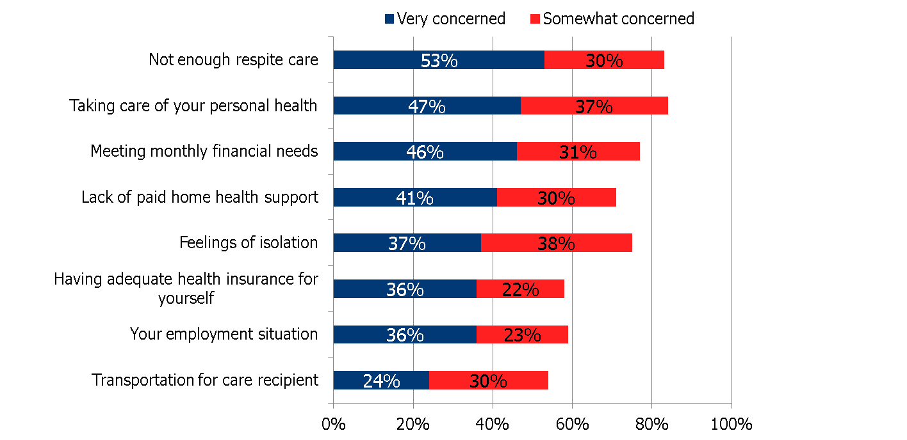
Top Concerns
15. Please rank your level of concern about the following challenges you face as a caregiver (Very, Somewhat, Not Very, Not at All)
Notes:
15
15
This is where I think the data starts to get really interesting
Lack of respite care not surprising as a big concern
BUT concern about their own health – 85% that tells me at least that the right messaging can convince family caregivers to
change their attitudes – one of NFCA’s four core principles is Protect Your Health
All respondents are concerned about these issues – not one was rated less than 50% and 5 of the 8 choices showed a 70%
level of concern

Slide 16
Concerns by Caregiving Role
Sole providers are the most concerned about the challenges of
caregiving, especially not enough respite care, and feelings of isolation.
 | Caregiving Role
% “Very” Concerned about | Sole provider | Primary with help | One of many who share | Help but not primary
Not enough respite care | 62% | 52% | 24% | 32%
Taking care of your personal health | 53% | 45% | 34% | 35%
Meeting monthly financial needs | 53% | 40% | 42% | 32%
Lack of paid home health support | 47% | 36% | 32% | 34%
Feelings of isolation | 47% | 32% | 21% | 18%
Having adequate health insurance for yourself | 41% | 31% | 34% | 20%
Your employment situation | 41% | 32% | 34% | 26%
Transportation for care recipient | 27% | 21% | 22% | 23%
Notes:
16
16
We looked at the caregivers’ concerns in relationship to the level of help they have
Sole providers (who are primarily spouses) are more concerned about everything than any other group of caregivers and
significantly so
This tells us this is a group of family caregivers, although not the most numerous, are the ones who need the most attention

Slide 17
Concerns by Duration of Caregiving
 | Duration of Caregiving
% “Very” Concerned about | Less than 1 year | 1-5 years | 5-10 years | More than 10 years
Not enough respite care | 45% | 53% | 51% | 58%
Taking care of your personal health | 43% | 45% | 48% | 51%
Meeting monthly financial needs | 47% | 45% | 45% | 48%
Lack of paid home health support | 40% | 39% | 41% | 44%
Feelings of isolation | 32% | 35% | 38% | 40%
Having adequate health insurance for yourself | 37% | 31% | 38% | 38%
Your employment situation | 43% | 36% | 36% | 35%
Transportation for care recipient | 20% | 23% | 22% | 27%
Notes:
17
17
We looked at time as a caregiver impacts concerns.
Note - they all increase over time, except employment
But concerns about money, home care, and health insurance increase but not a lot – they are concerns all through someone’s
caregiving journey
Those who have been giving care for less than a year are more concerned about
their employment situation than those who have been giving care for longer.

Slide 18
Concerns by Evolution of Caregiving Role
Those thrown suddenly into the caregiving role are the most concerned
about the challenges of caregiving, especially not enough respite care.
 | Evolution of Caregiving Role
% “Very” Concerned about | Thrown suddenly into role | Role developed slowly over years
Not enough respite care | 60% | 46%
Taking care of your personal health | 53% | 42%
Meeting monthly financial needs | 51% | 42%
Lack of paid home health support | 46% | 36%
Your employment situation | 42% | 31%
Feelings of isolation | 41% | 34%
Having adequate health insurance for yourself | 40% | 32%
Transportation for care recipient | 25% | 22%
Notes:
18
18
Look at how the levels of concern change depending upon caregiving came suddenly or gradually
Time was a factor in level of concern but it seems that caregivers never get over the impact of suddenly being thrown into their
role – something else to think about when we consider how and when to reach out to them

Slide 19
Implications
These data suggest the need for further exploration into the various correlations of
-family caregiver role (sole, primary, etc.)
-evolution of role (developed gradually or suddenly)
-and duration of family caregiving.
Caregiver interventions and programming can be developed that is informed by these correlations with messages tailored to the needs and concerns of specific subsets of the higher burden population.
Notes:
This survey is a first stab at looking at the complexities involved in the lives of higher burden family caregivers. It suggests lots
of additional avenues of research and gives us insights into how to be most helpful to specific segments of the caregiving
population.
What is really exciting for us is that - of the more than 1,500 family caregivers who responded to the survey – over a third said they’d be interested in participating
in other surveys and being called upon to be active in advocacy.

Slide 20
It is generally accepted that a family caregiver is considered a high burden family caregiver if they assist their loved one with personal care such as getting dressed, bathing and incontinence. While this survey indicates that half to two thirds of the respondents assist with these activities, the findings expand upon that by revealing the other characteristics of a high burden family caregiver.
Suzanne Mintz

Slide 21
Thank You!!!!
National Family Caregivers Association
www.thefamilycaregiver.org
.

